Slide 1

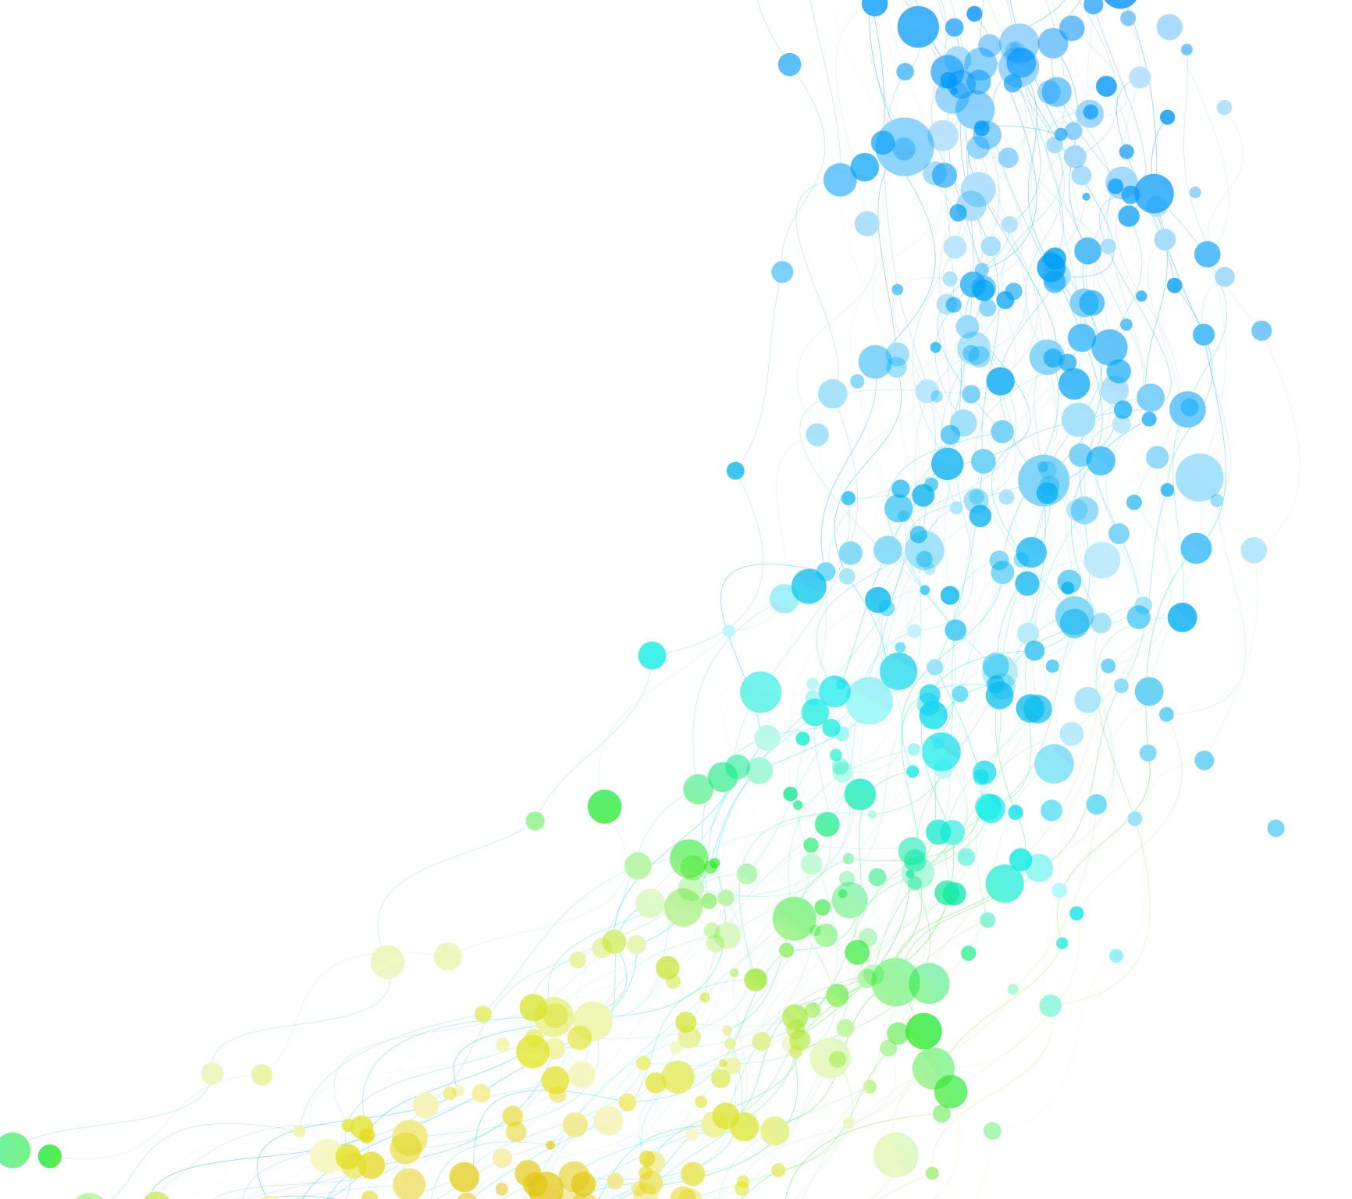
Neural-Kalman Schemes for Non-Stationary Channel Tracking and Learning March 13, 2023
Diego Méndez Romero M. Julia Fernández-Getino García PhD Advisor

Slide 2
Index
Our goal
Statement of the problem
Abrupt changes
Kalman filtering (KF)
Novel contributions
Simplified Maximum a Posteriori (SMAP)
Neural-Network-switched Kalman Filters (NNKF)
Partial taps
Neuro-financial

Slide 3
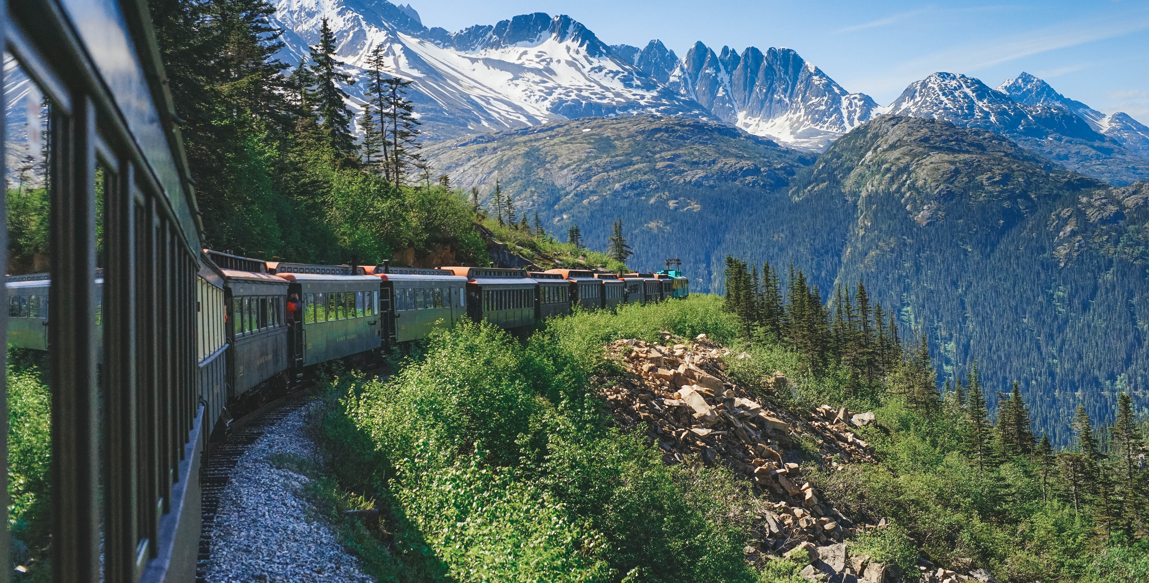
Our goal
Highly mobile applications > nonstationary Example: a train
close to a station
crossing a bridge
entering a tunnel
This can be modeled as abrupt changes.

Slide 4
Our goal
Devise novel channel trackers:
exploit KF
exploit the advantages of Kalman filtering while preventing degradation in the face of abrupt changes
low-complexity
for applicability to real-world communication purposes.

Slide 5
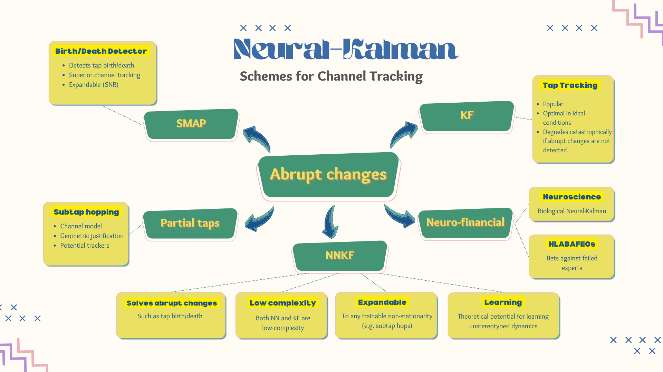

Slide 6
Statement of the problem
Abrupt changes
Kalman filtering

Slide 7
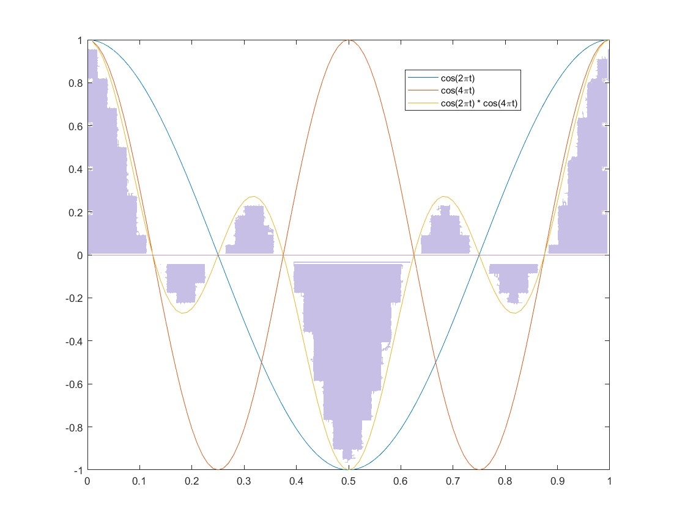
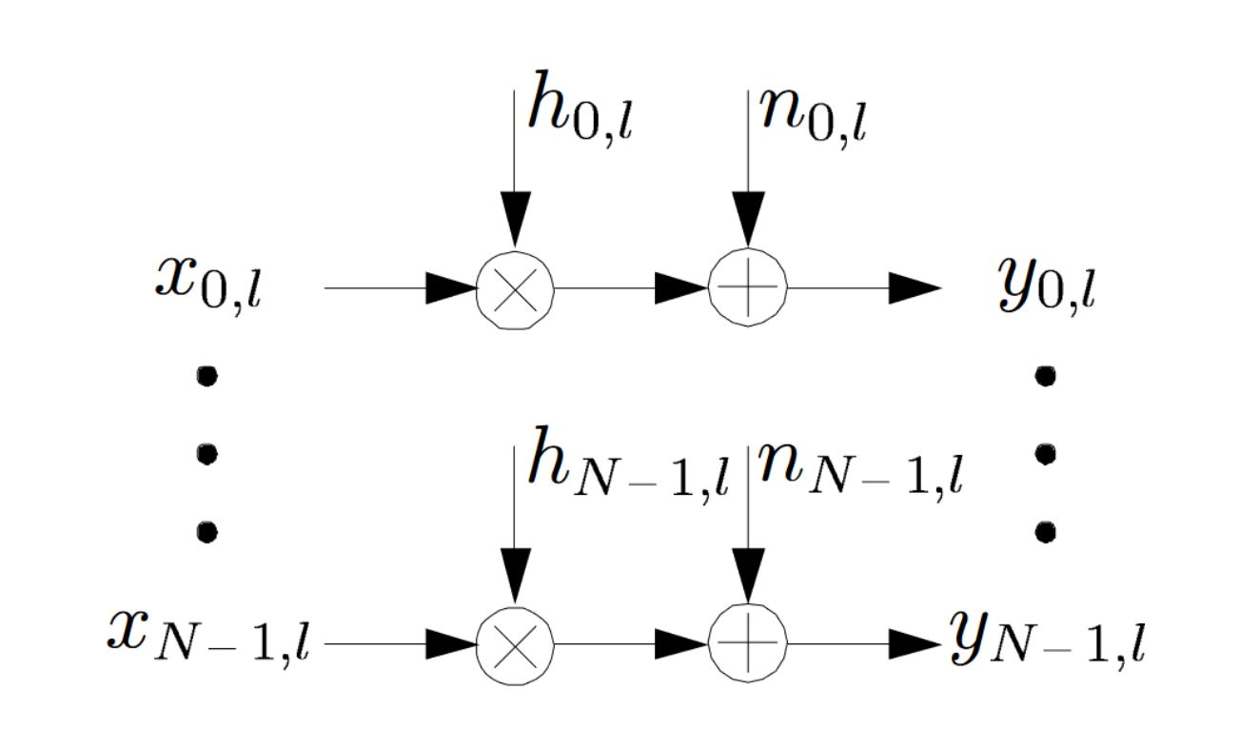
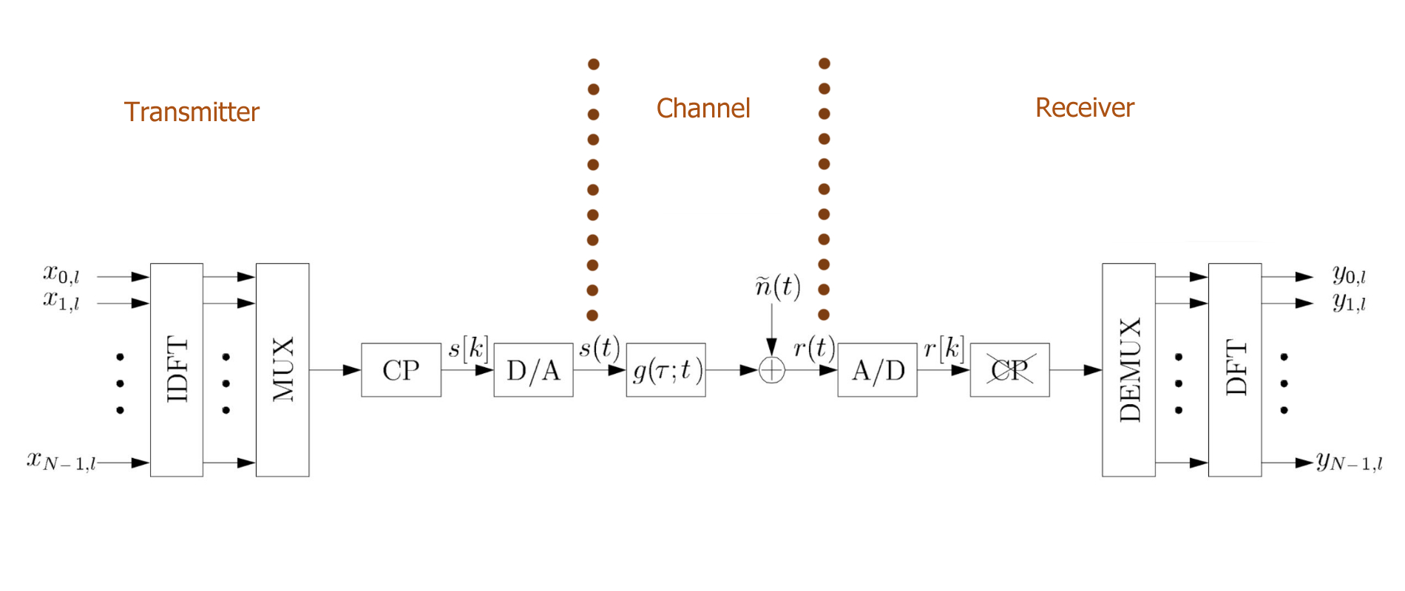
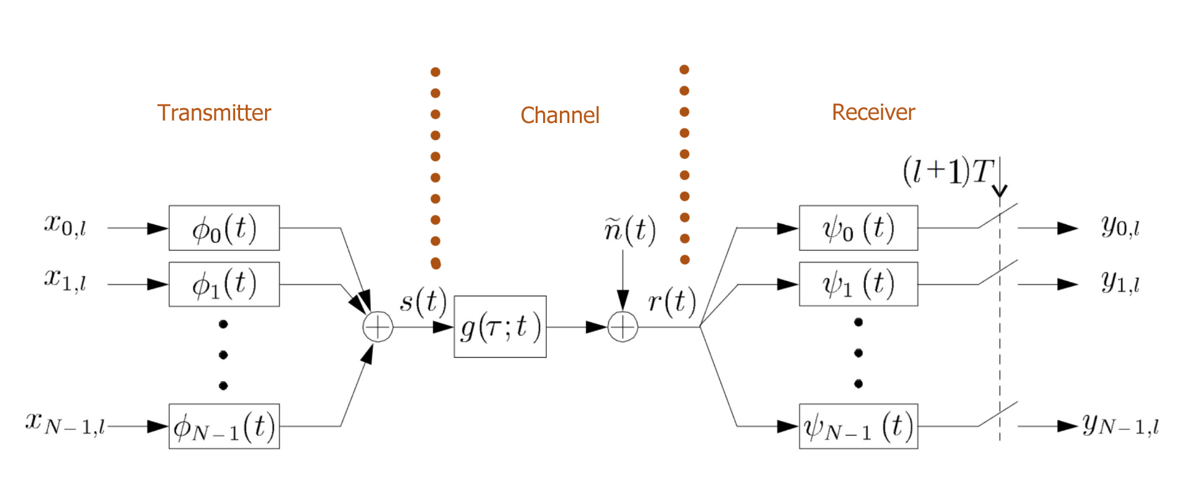
OFDM system
[Edfors et al., 1996]

Slide 8
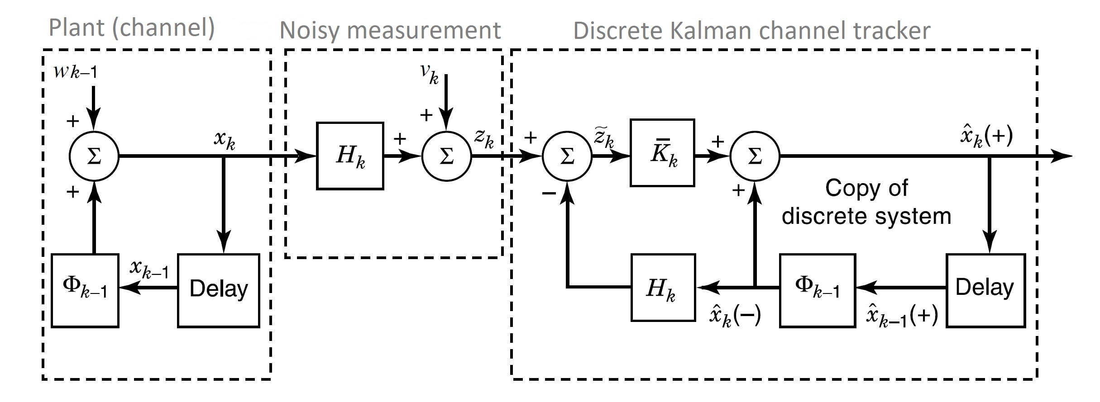
Kalman filtering (KF)
[Grewal and Andrews, 2015]

Slide 9
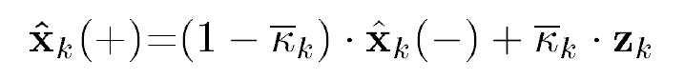
Basic KF equation
Our goal: find updated estimate of “signal”
2 information sources get mixed: model vs. noisy measurement

Slide 10
KF steps
1. Error covariance extrapolation
2. State estimate gets updated with the new reading
3. Error covariance update
4. Computation of the Kalman gain

Slide 11

KF for OFDM: lit rev
KF can improve channel estimation and reduce BER.
Typical proposal: KF to track subchannels’ temporal variation.
Matrix KF can be simplified into a bank of scalar KFs.
KF degrades catastrophi-cally if tap birth/death.

Slide 12
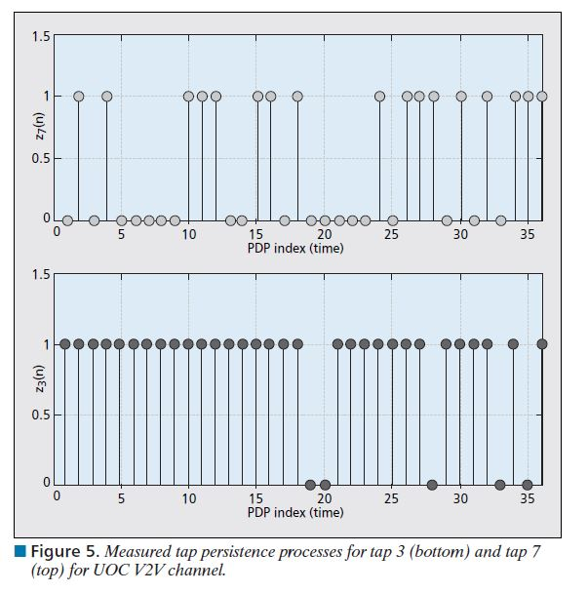
Tap persistence process
[Matolak, 2008]

Slide 13
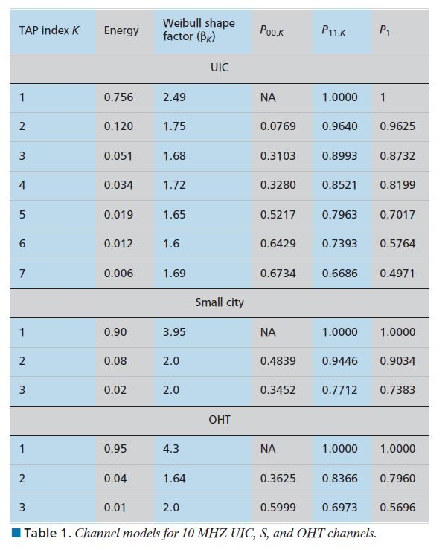
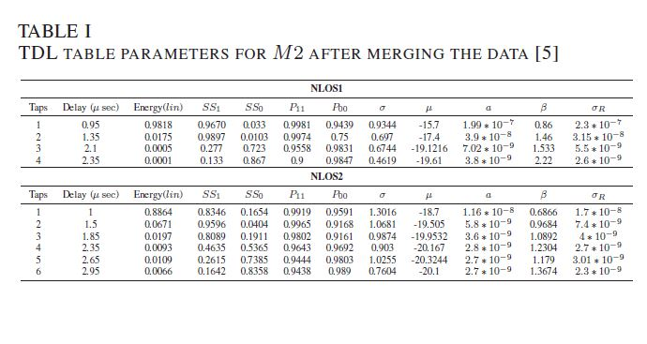
Empirical values for tap death/birth
[Matolak, 2008]
[Hassan et al., 2020]

Slide 15
Novel contributions
→ SMAP
NNKF
Partial taps
Neuro-financial

Slide 16
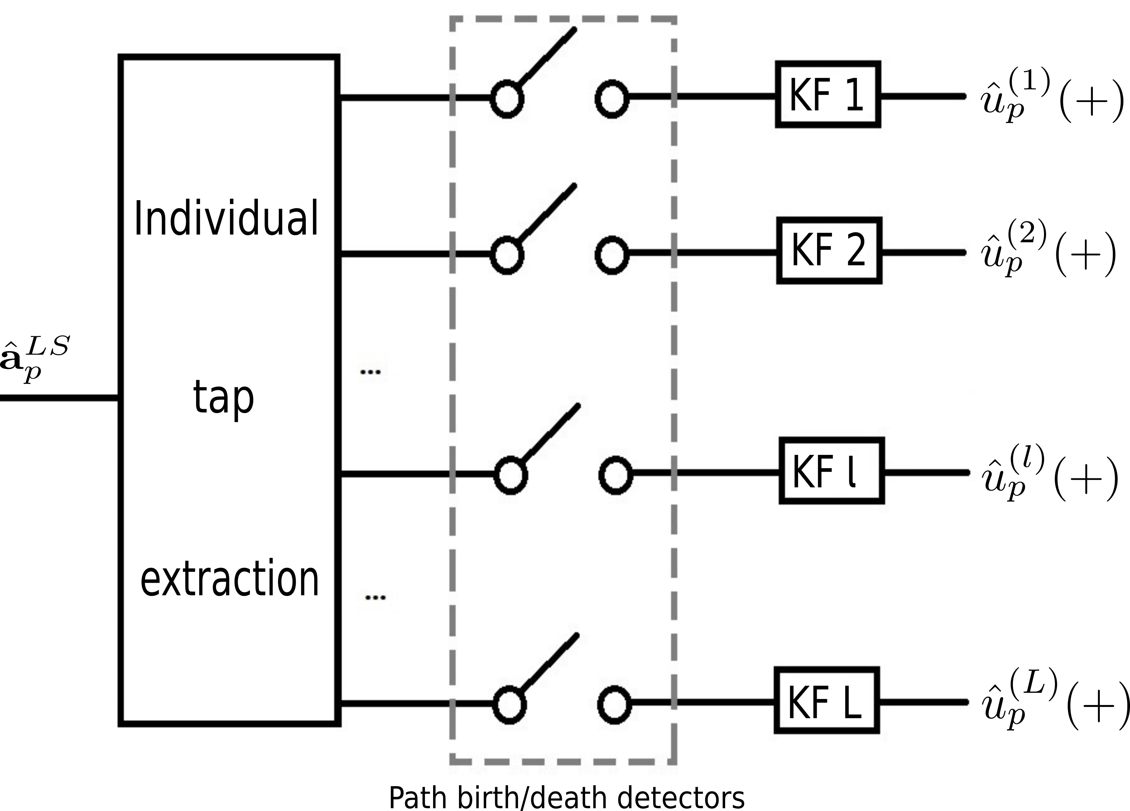
Simplified Maximum A Posteriori (SMAP) Multipath Detection

Slide 17

Three heuristics
Sudden death
tap gain leaps into approx. zero
Slow death
tap gain has slowly converged into approx. zero
Birth
the tap gain is far from zero

Slide 18
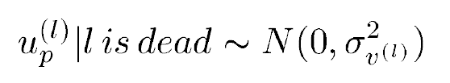
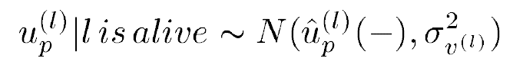
Sudden death
Detect death if:

Slide 19
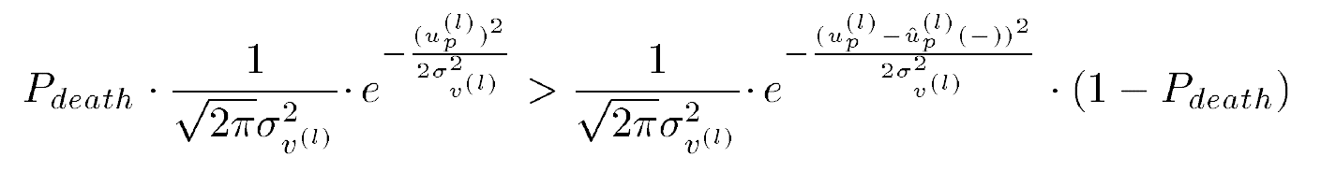
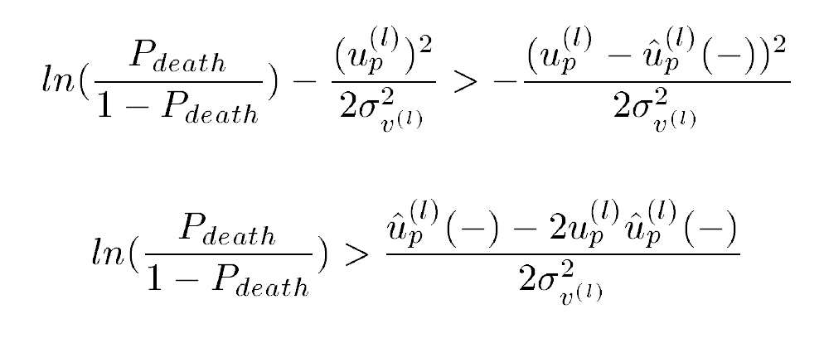
Sudden death
By taking logarithms:

Slide 20
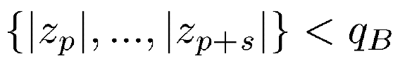
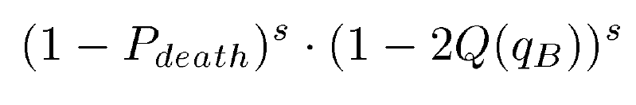
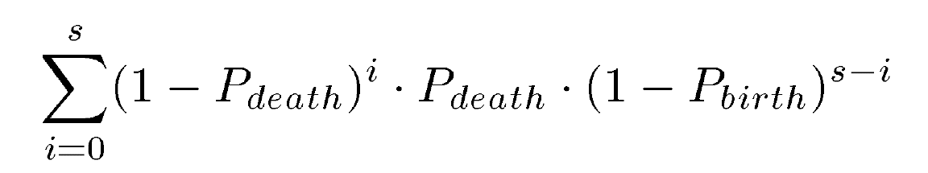
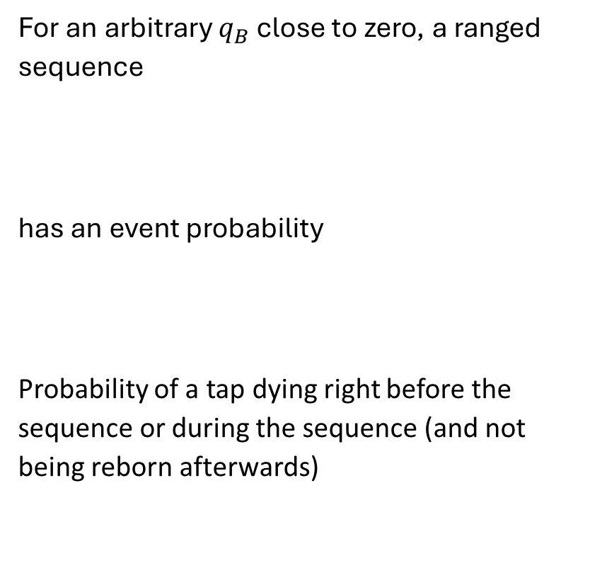
Slow death
For an arbitrary $q_{B}$ close to zero, a ranged sequence
has an event probability
Probability of a tap dying right before the sequence or during the sequence (and not being reborn afterwards)

Slide 21
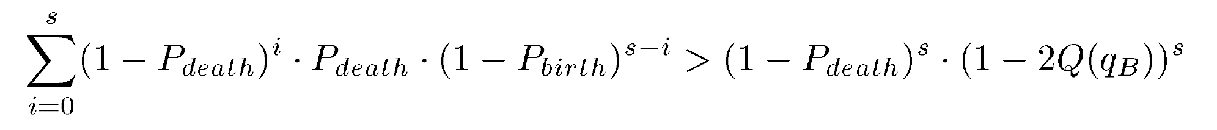
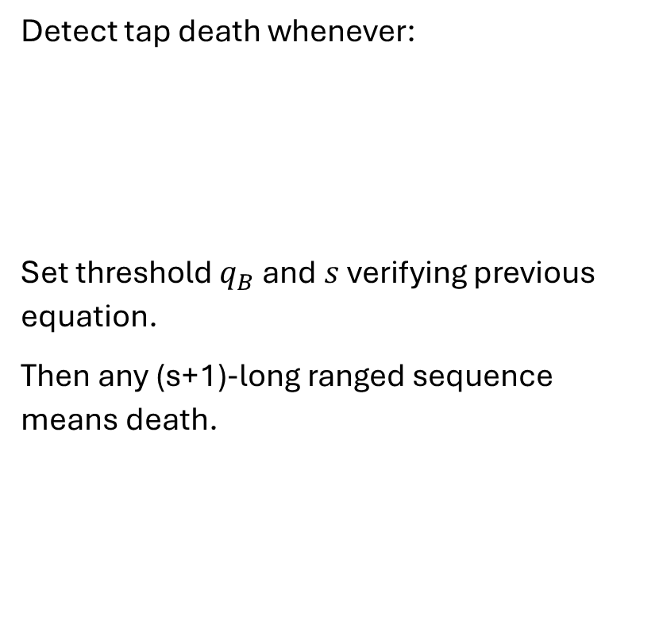
Slow death
Detect tap death whenever:
Set threshold $q_{B}$ and $s$ verifying previous equation.
Then any (s+1)-long ranged sequence means death.

Slide 22
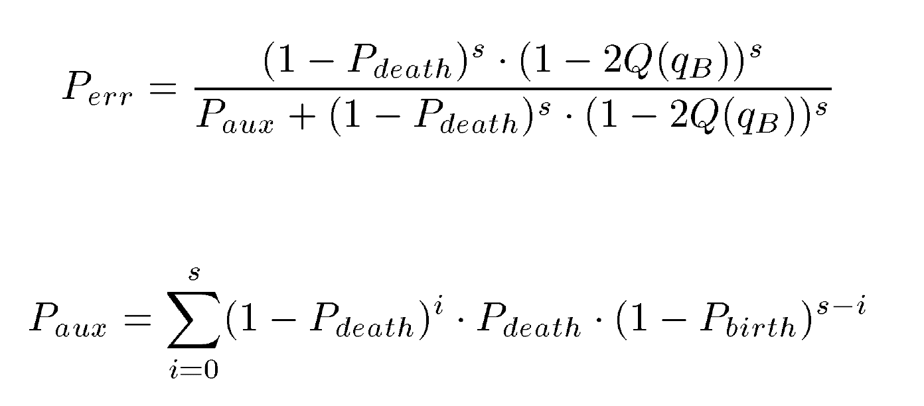
Slow death
Probability of having made the wrong decision can be shown [Méndez-Romero and Fernández-Getino García, 2018] to be:

Slide 23
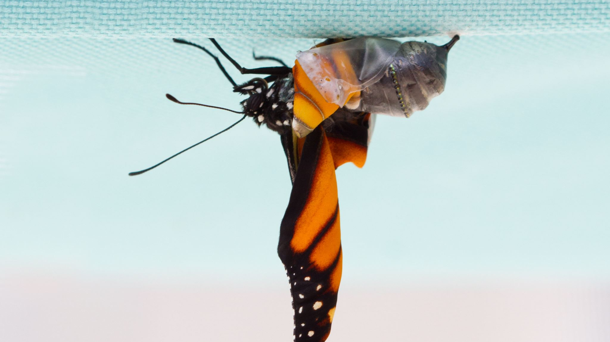

Birth
$$P_{corr}+P_{birth_det}>P_{false_det}$$

Slide 24
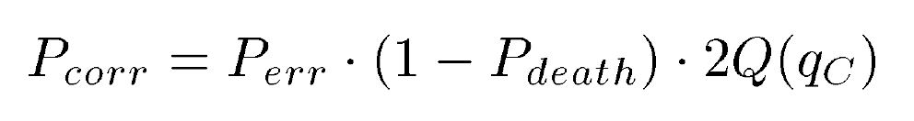
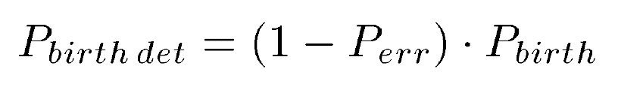
Birth

Slide 25
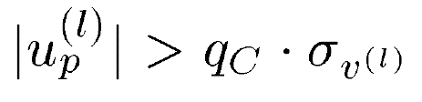
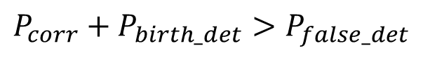
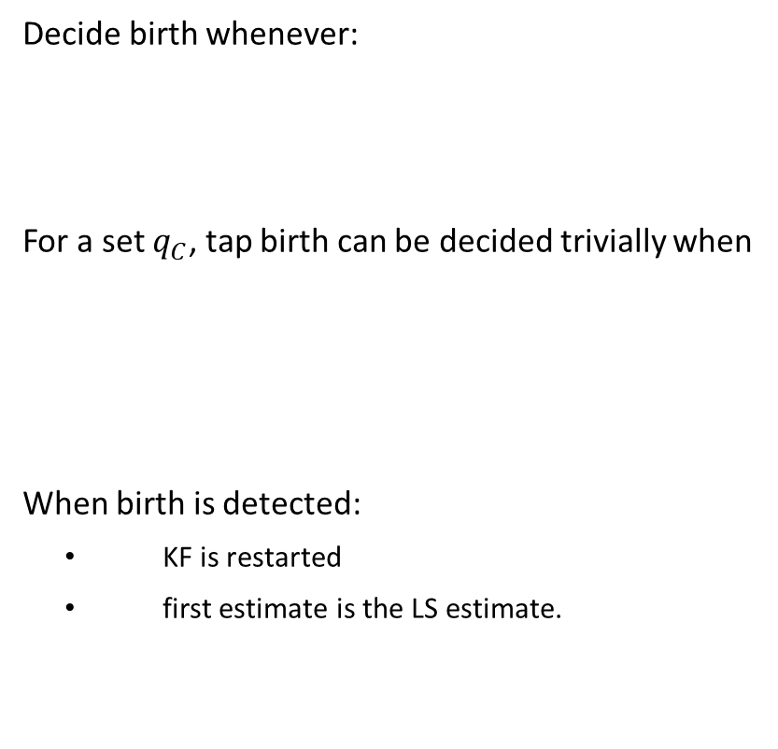
Birth
Decide birth whenever:
For a set $q_{C}$, tap birth can be decided trivially when
When birth is detected:
KF is restarted
first estimate is the LS estimate.
$$P_{corr}+P_{birth_det}>P_{false_det}$$

Slide 26
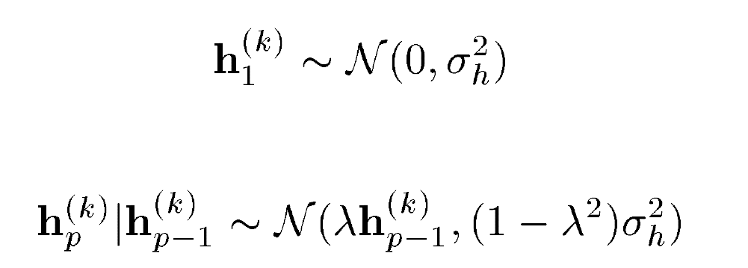
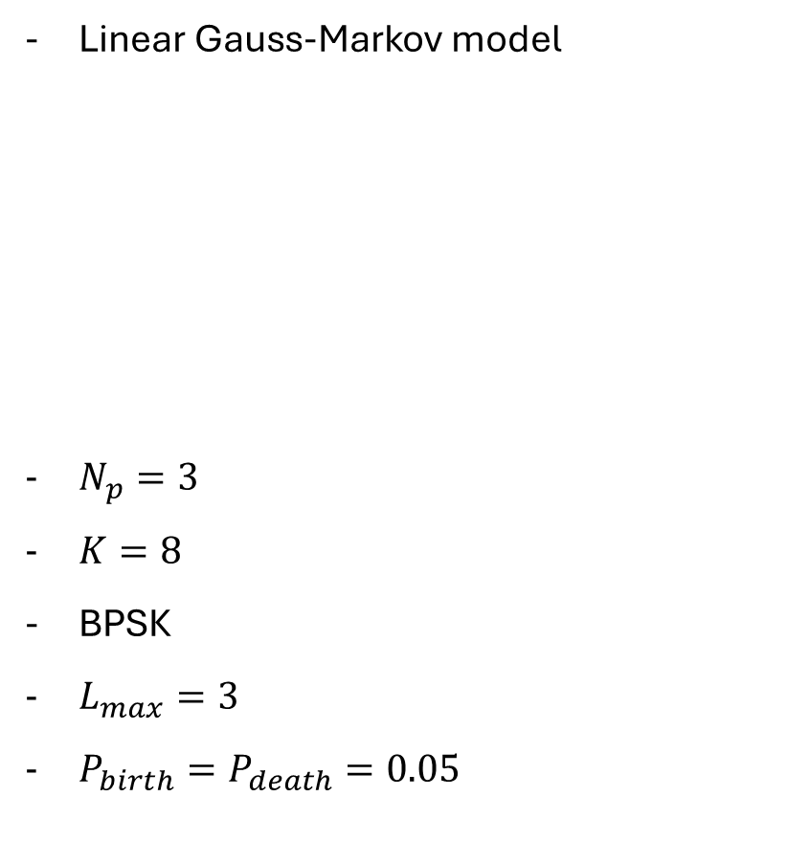
SMAP simulation
Linear Gauss-Markov model
$N_{p}=3$
$K=8$
BPSK
$L_{max}=3$
$P_{birth}=P_{death}=0.05$

Slide 27
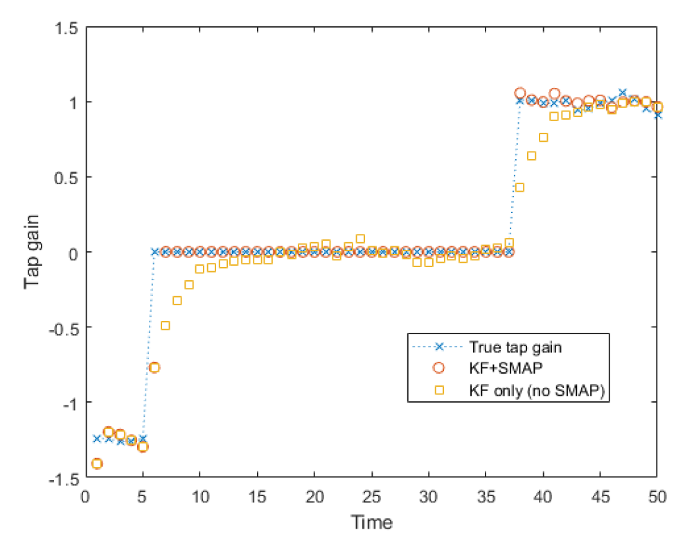
KF does not detect change-points

Slide 28
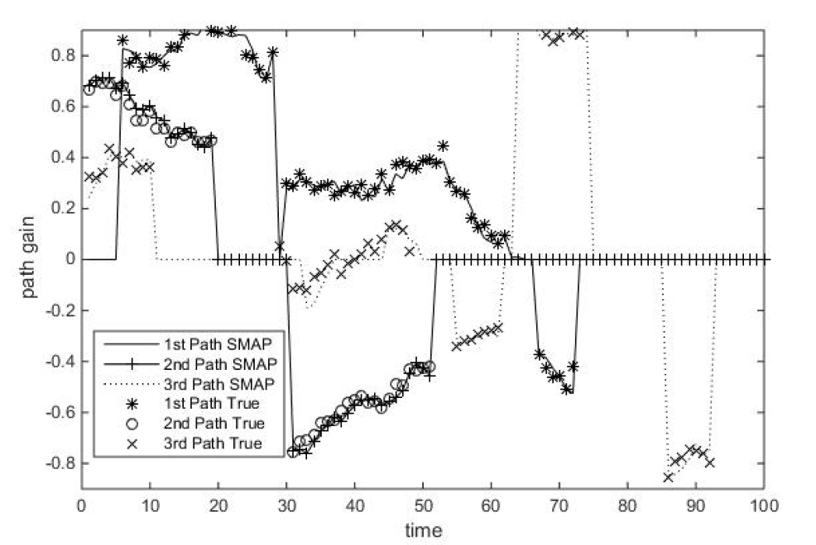
SMAP detects changepoints

Slide 29
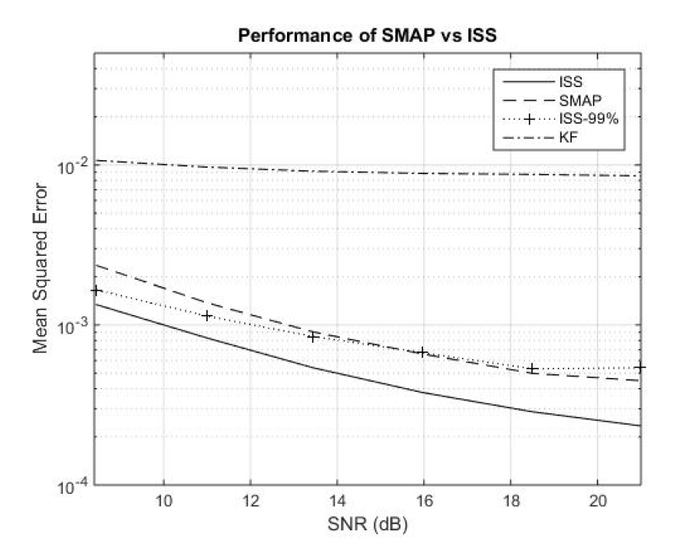
SMAP reduces estimation error

Slide 30
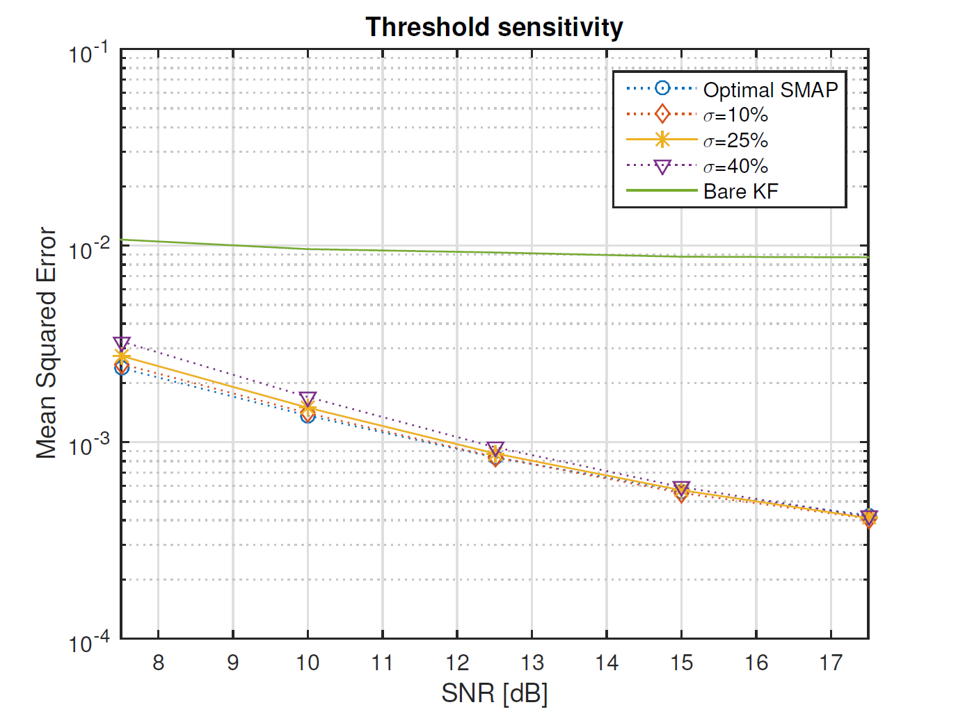
SMAP is not overfitted

Slide 31
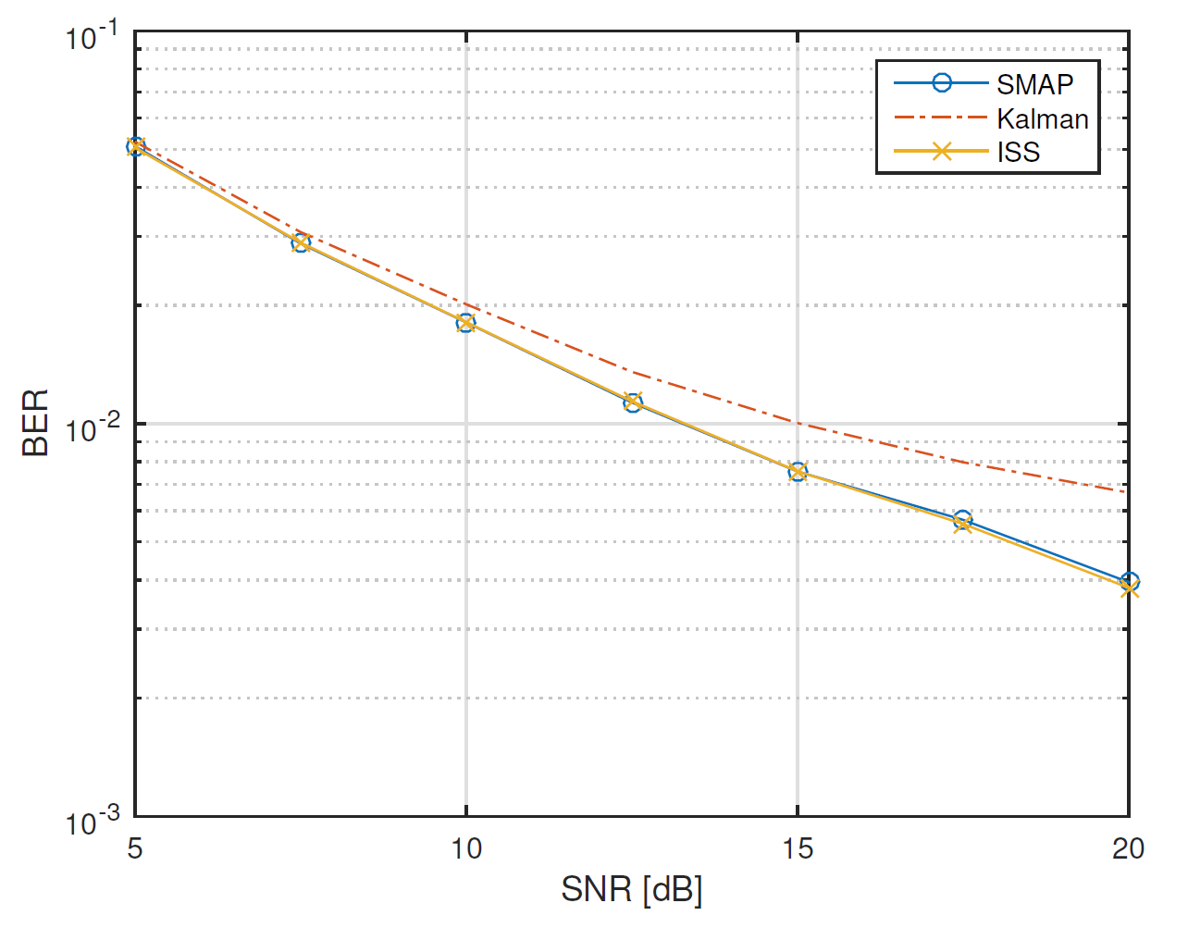
SMAP reduces BER

Slide 32
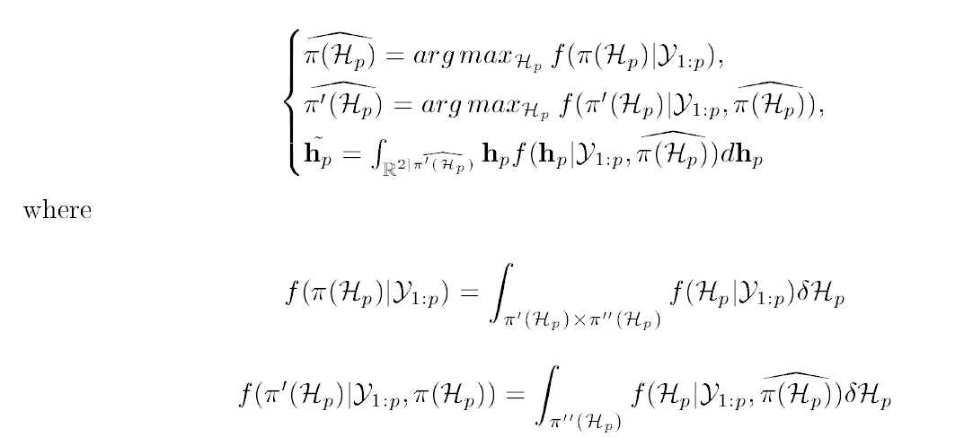
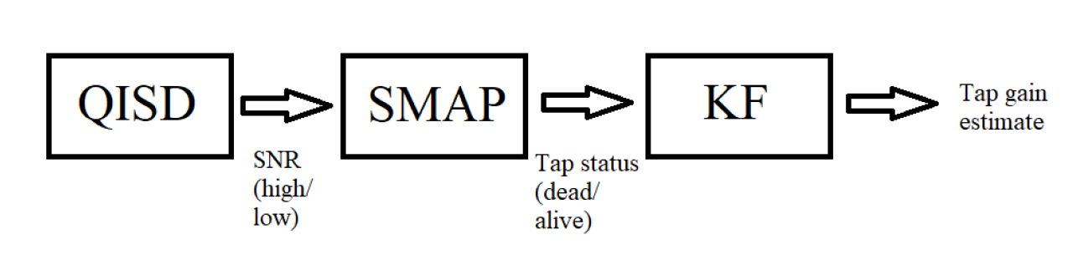
SNR + SMAP

Slide 33
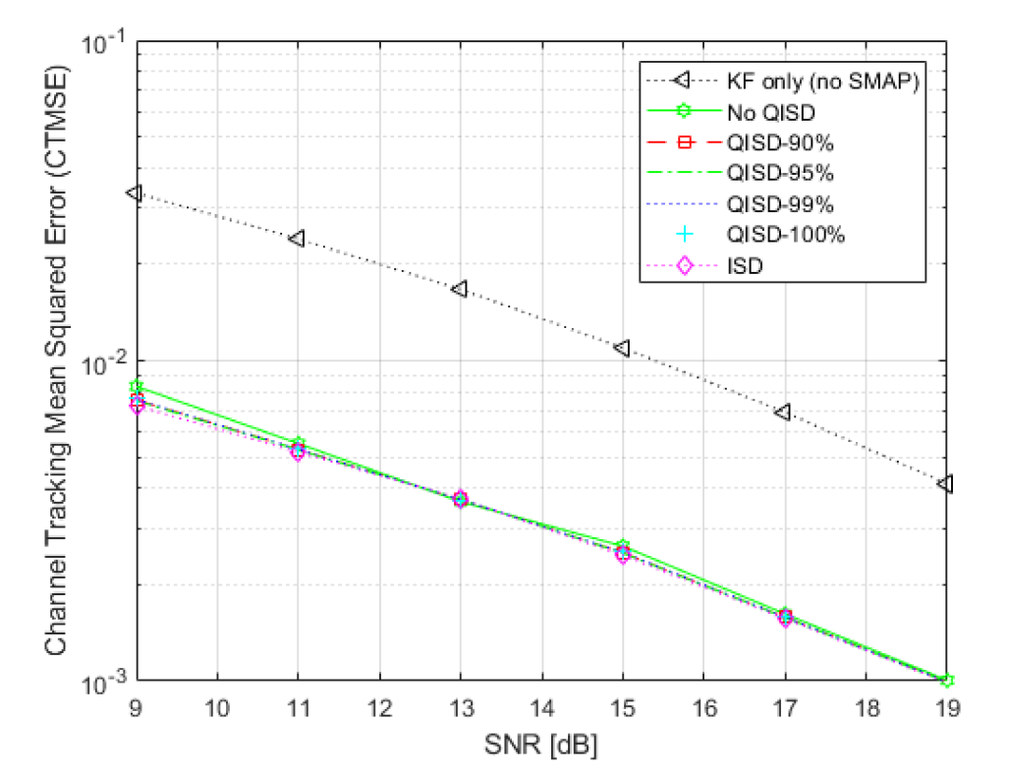
SNR + SMAP slightly improves performance

Slide 34
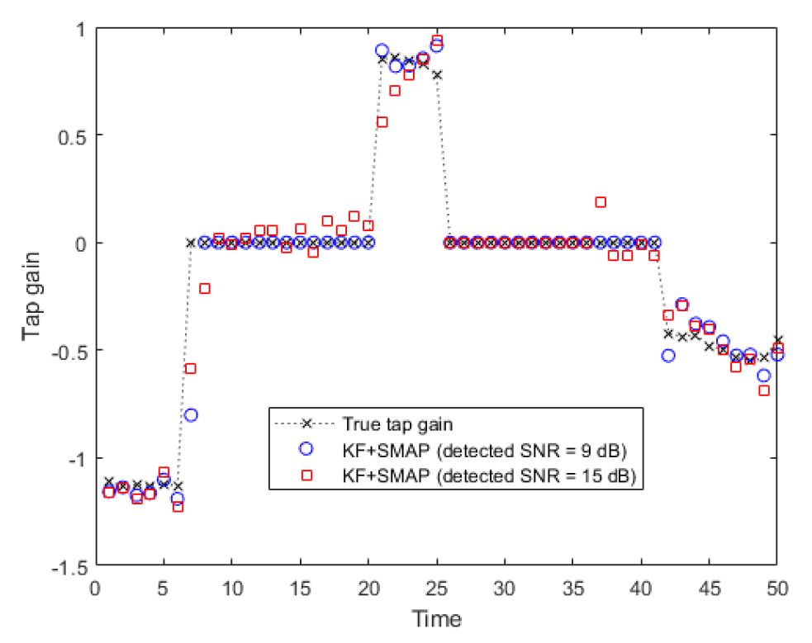
SMAP is robust to SNR drift
Kalman tracker with birth/death detector when SNR detection is correct (9 dB) and incorrect (15 dB).

Slide 36
Novel contributions
SMAP
→ NNKF
Partial taps
Neuro-financial

Slide 37
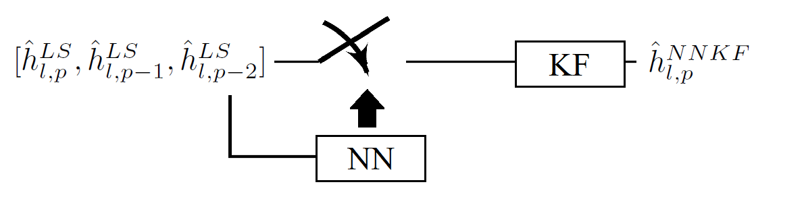
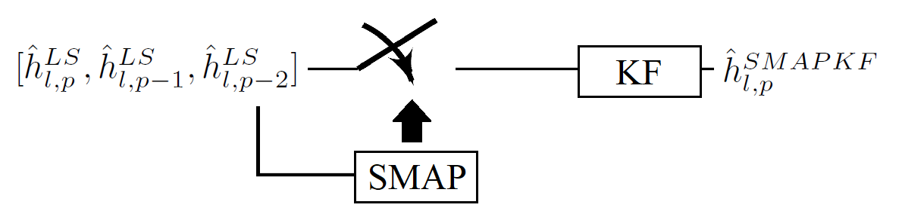
Neural-Network-switched Kalman Filters (NNKF)

Slide 38
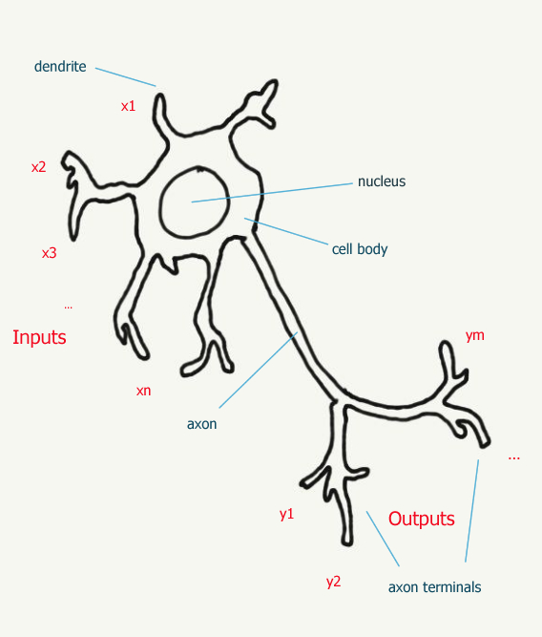
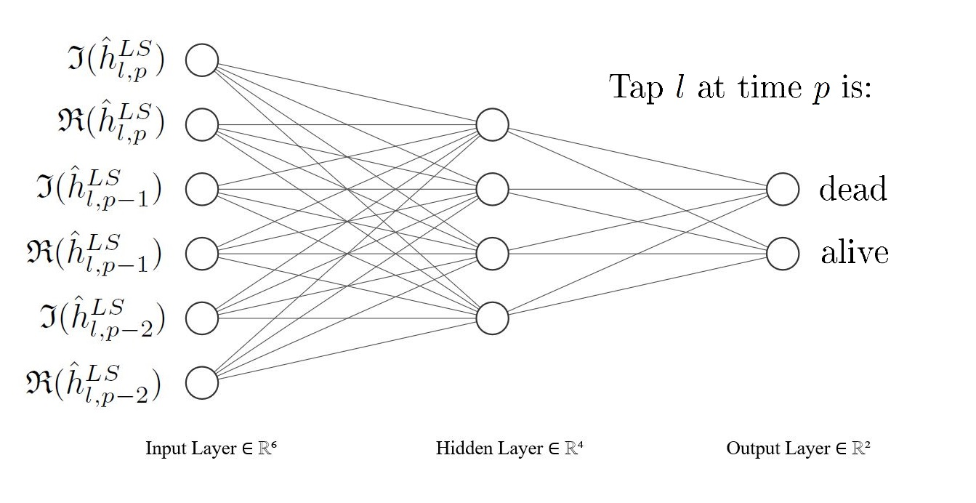
Neural Networks

Slide 39
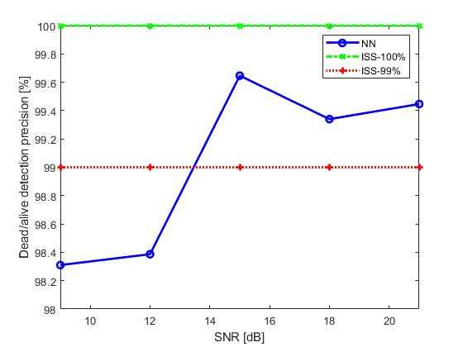
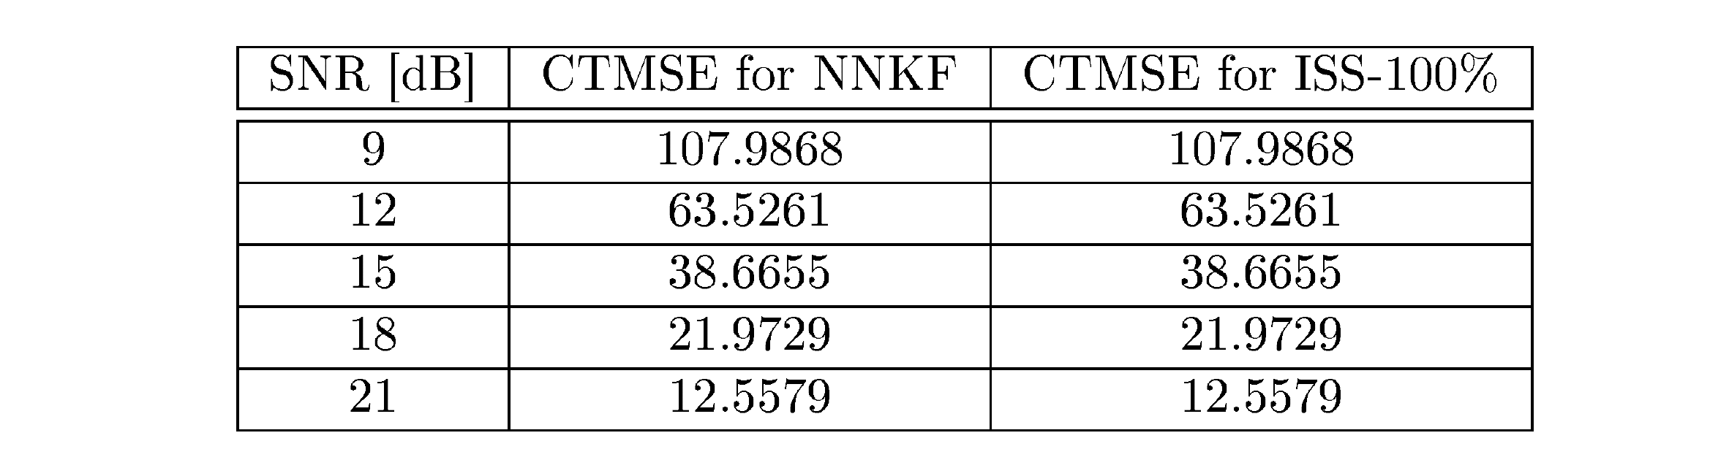
NNKF detects birth/death, improves CTMSE
NNKF detects dead/alive status correctly about 99% of the time. The other 1% has negligible effect on Channel Tracking Mean Square Error (CTMSE). Thus, NNKF performs as a perfect detector.

Slide 40
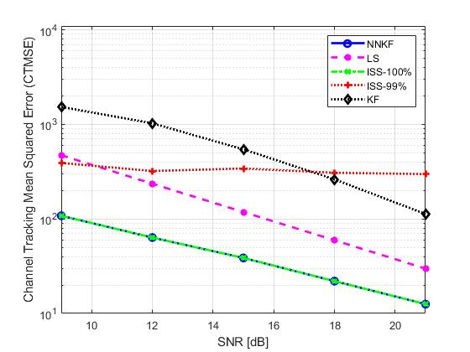
Perfect tracking precision

Slide 41
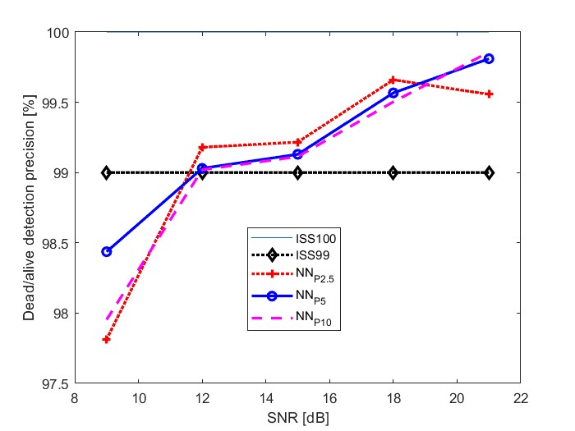
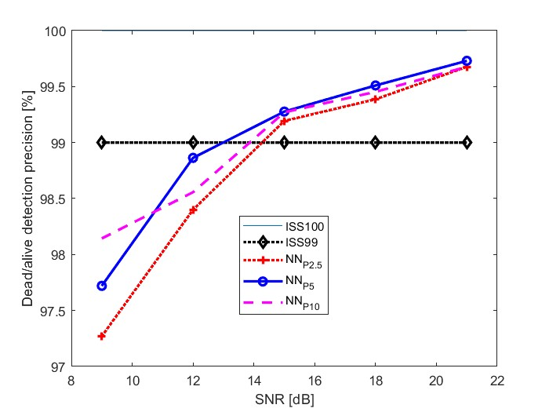
Robust to P
A single, low-complexity NNKF could be reusable
Tested for P = 2.5%
Tested for P = 10%

Slide 43
Novel contributions
SMAP
NNKF
→ Partial taps
Neuro-financial

Slide 44
Partial tap dynamics
5 geometrically-justified tap dynamics (birth-death / hop) involving either full or partial taps:
Uncorrelated (sub)tap birth-death dynamics
Correlated (sub)tap birth-death dynamics
Gradual tap drift
Lateral (sub)tap hop dynamics
Unstereotyped dynamics

Slide 45

Correlated subtaps
A truck in a highway is a reflecting obstacle that can cause correlated (sub)tap birth/death dynamics.

Slide 46

Correlated subtaps
The truck is large enough for several adjacent taps to appear at once [Hassan et al., 2020].
Large truck exits > all taps disappear
Uncorrelated assumption is not suitable

Slide 47

Correlated subtaps
Drone swarm transitorily shadowed

Slide 48

Gradual tap drift

Slide 49



Lateral subtap hopping
Highway: LOS + reflections on vehicles.
Interfering vehicle gets closer -> echo path will resemble the LOS.

Slide 50


Lateral hopping example

Slide 51


Lateral hopping example

Slide 52


Lateral hopping example

Slide 53


Lateral hopping example

Slide 54

Unstereotyped dynamics
Can a channel tracker learn new abrupt phenomena as they happen?

Slide 55
Partial tap dynamics
5 geometrically-justified tap dynamics (birth-death / hop) involving either full or partial taps:
Uncorrelated (sub)tap birth-death dynamics
Correlated (sub)tap birth-death dynamics
Gradual tap drift
Lateral (sub)tap hop dynamics
Unstereotyped dynamics

Slide 56


A model for partial taps

Slide 57


Partial tap hopping

Slide 58

A neural detector for lateral hops

Slide 59

Good performance
Suitable for integration into NNKF schemes.

Slide 61
Novel contributions
SMAP
NNKF
Partial taps
→ Neurofinancial

Slide 62

The NNKF/KF divide is everywhere
Finance
Neuroscience
Communications
Emergencies
Continual Learning (AI)

Slide 63


Abrupt changes both in finance and communications

Slide 64


Slide 65





Slide 66
Neural-Kalman Market Hypothesis
Abrupt changes
drive financial markets
Most don’t understand them › KF
A few understand them › NNKF
Neural-Kalman Phenomena
Bets against KF = Outperformance
HLABAFEOs

Slide 67

Investors as KF vs. NNKF

Slide 68

Neurosocial evidence for NKP
Normalcy bias in emergency research [Ripley, 2009]
When Experts Fail [Graham, 2014]
Anchoring (cognitive bias) [Tversky and Kahneman, 1974, Yasseri and Reher, 2022]
Black Swans in Extremistan [Taleb, 2007, Taleb, 2020]
Gray Rhinos [Wucker, 2016]
Escalation of commitment to a failing proposition [Staw, 1976, Staw, 1996]
Mirror neuron system [Keysers and Fadiga, 2009] and mimetic desire

Slide 69



Real-world HLABAFEO performance

Slide 70
Takeaways for engineering
Topics in neuroscience are relevant for engineering.
Changepoint-Oddball-Reversal is functionally equivalent to channel tracking problem under abrupt changes.
SMAP estimator can be reinterpreted as a detector for changepoints, oddballs and reversals.
Bio-inspired mechanisms for channel tracking and learning under unstereotyped dynamics.
An NK architecture for ever granular stereotyping for continual learning
Mechanisms eventually elucidated in neuroscientific research

Slide 71
Final summary

Slide 73
Conclusions
The Kalman filter is great if no abrupt changes.
If abrupt changes, you need a detector (SMAP, NNKF).
Neural-Kalman dynamics can be exploited (hopping, HLABAFEOs).

Slide 74
Further lines of research
1. Applying NNKF to different real environments
2. Simulating different partial tap dynamics and detectors
3. Empirical characterization of partial tap hopping
4. Applying NNKF to 6G and smart mobility
5. Solve unstereotyped abrupt dynamics via NK schemes
6. Neurofinancial research of HLABAFEOs

Slide 75

Thanks for your attention. Any questions?

